Slide 1

열정을 가진 자들이 모여 세상을 개척한다
심화반 Week 5.
Recurrent Neural Network
Presenter: Daehyun Kim
GDG Campus Korea
MODULABS AI/SW Lab.

Slide 2
01
Recurrent Neural Network

Slide 3
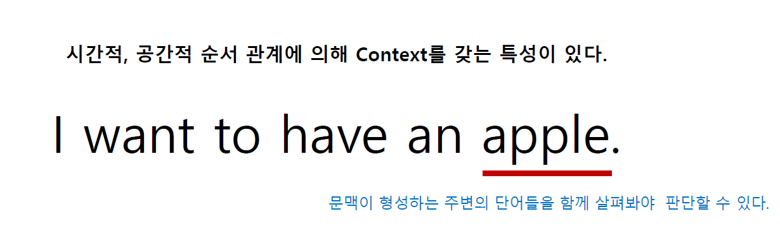
PNP
PASSSION & PIONEER
Recurrent Nerual Network
RNN

Slide 4
PNP
PASSSION & PIONEER
Recurrent Nerual Network
RNN
여기에 ???
우리가 모델이 되어서 모델링을 해보자

Slide 5
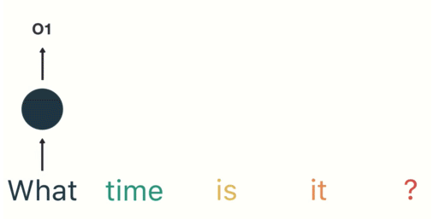
PNP
PASSSION & PIONEER
Recurrent Nerual Network
RNN
내 물건을 으러 여기에 ???
https://towardsdatascience.com/illustrated-guide-to-recurrent-neural-networks-79e5eb8049c9

Slide 6
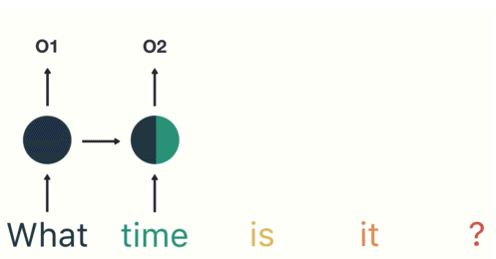
PNP
PASSSION & PIONEER
Recurrent Nerual Network
RNN
https://towardsdatascience.com/illustrated-guide-to-recurrent-neural-networks-79e5eb8049c9

Slide 7
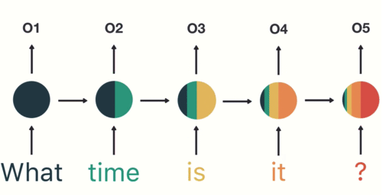
PNP
PASSSION & PIONEER
Recurrent Nerual Network
RNN
https://towardsdatascience.com/illustrated-guide-to-recurrent-neural-networks-79e5eb8049c9

Slide 8
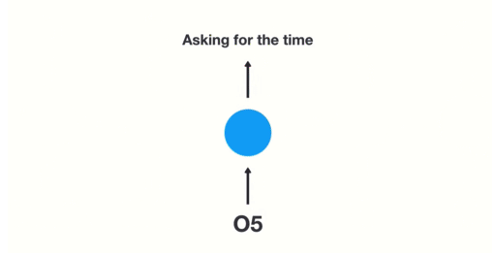
PNP
PASSSION & PIONEER
Recurrent Nerual Network
RNN
https://towardsdatascience.com/illustrated-guide-to-recurrent-neural-networks-79e5eb8049c9

Slide 9

PNP
PASSSION & PIONEER
Recurrent Nerual Network
Speech Recognition

Slide 10

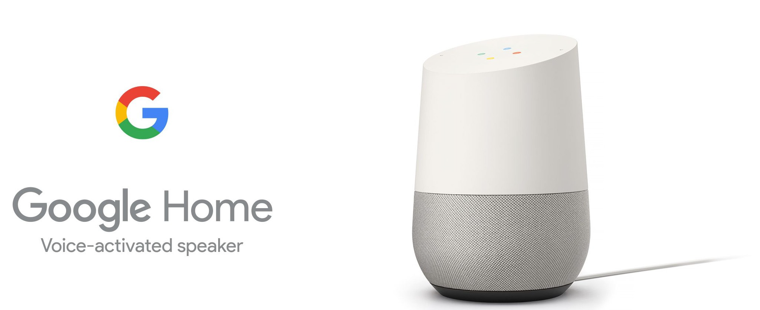
PNP
PASSSION & PIONEER
Recurrent Nerual Network
Speech Recognition

Slide 11

PNP
PASSSION & PIONEER
Recurrent Nerual Network
Machine Translation
http://blog.webcertain.com/machine-translation-technology-the-search-engine-takeover/18/02/2015/
https://www.youtube.com/watch?v=06olHmcJjS0

Slide 12
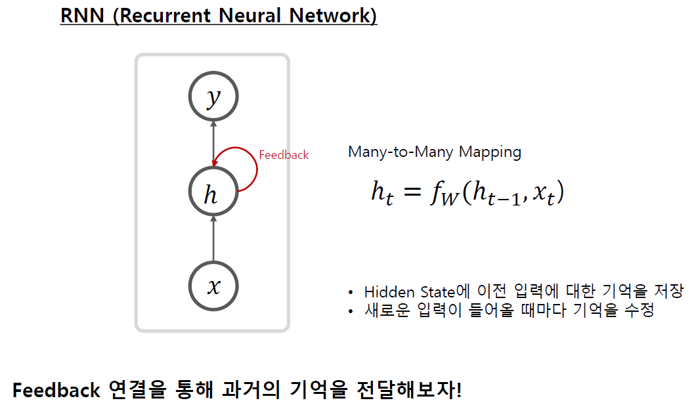
PNP
PASSSION & PIONEER
Recurrent Nerual Network
RNN
FeedBack -> hidden state (은닉 상태)

Slide 13
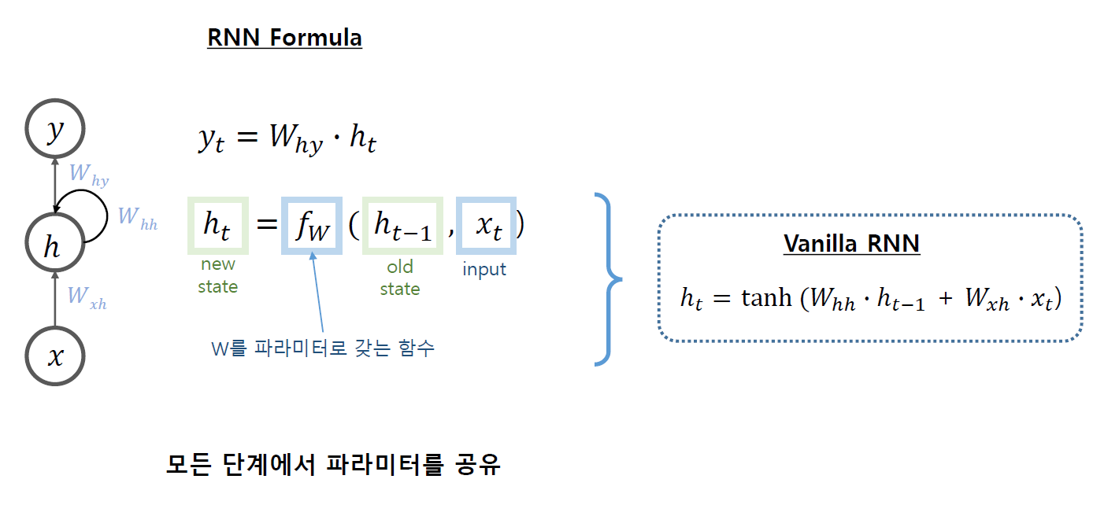
PNP
PASSSION & PIONEER
Recurrent Nerual Network
RNN

Slide 14
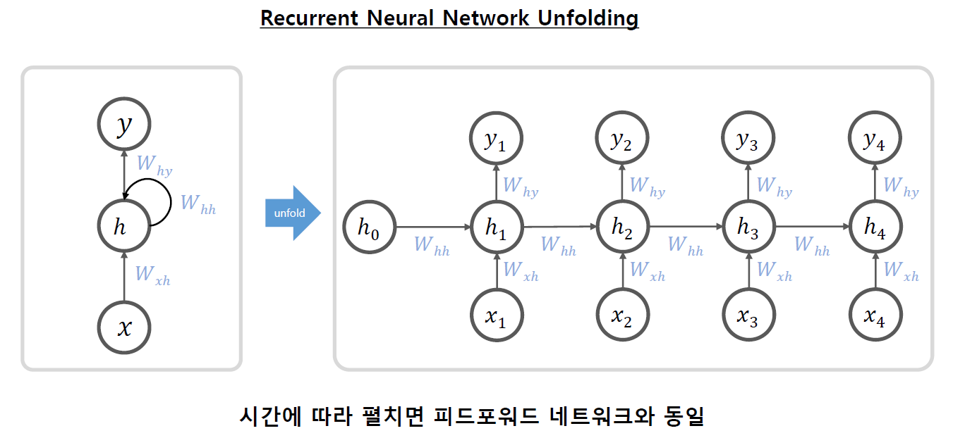
PNP
PASSSION & PIONEER
Recurrent Nerual Network
RNN

Slide 15
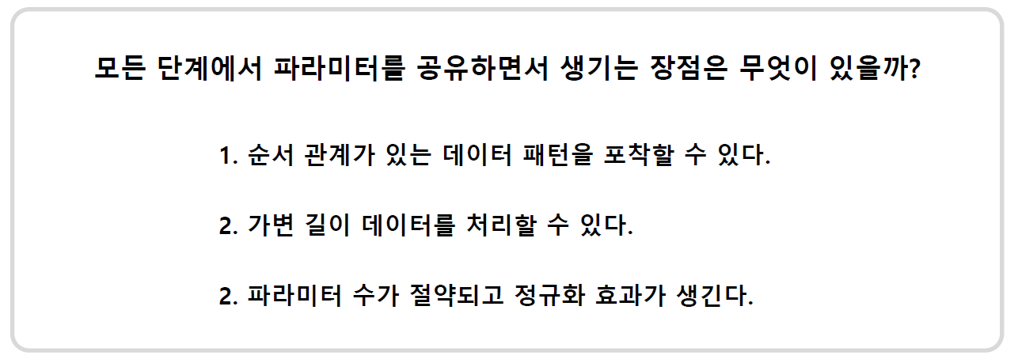
PNP
PASSSION & PIONEER
Recurrent Nerual Network
RNN

Slide 16
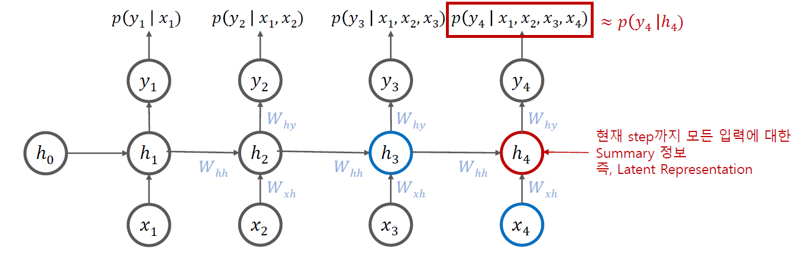
PNP
PASSSION & PIONEER
Recurrent Nerual Network
RNN
예측 과정 y1 -> x2

Slide 17
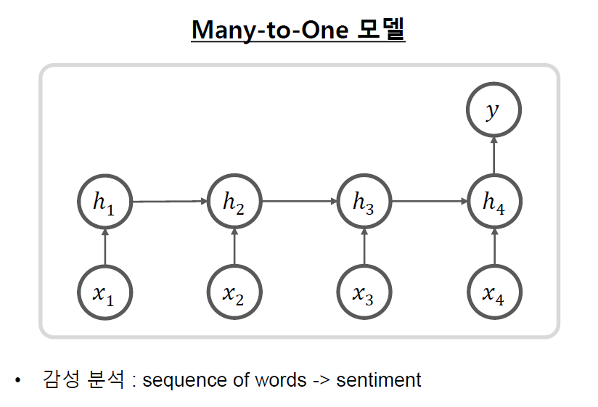
PNP
PASSSION & PIONEER
Recurrent Nerual Network
RNN – Many to One
Decoder
Encoder

Slide 18
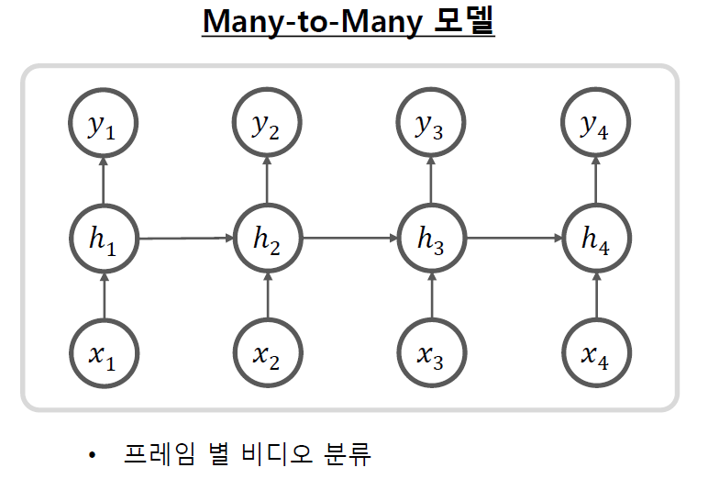
PNP
PASSSION & PIONEER
Recurrent Nerual Network
RNN – Many to Many
예측해서 단어 생성

Slide 19
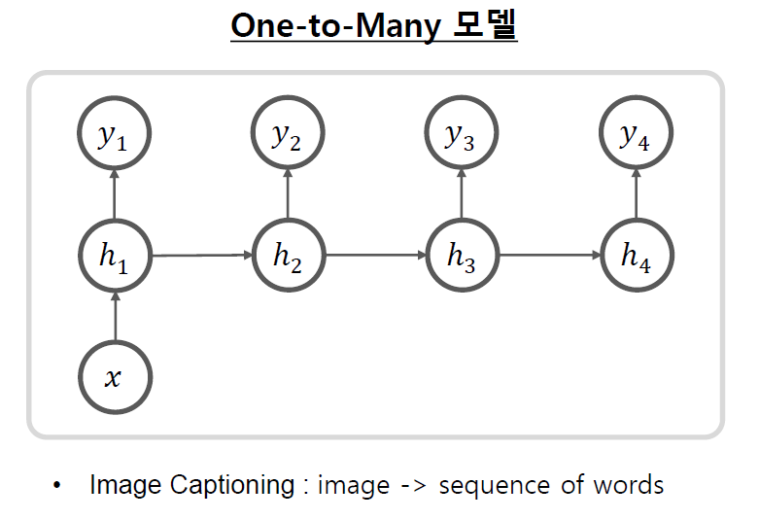
PNP
PASSSION & PIONEER
Recurrent Nerual Network
RNN – One to Many
하나입력 -> 다양한 예측

Slide 20
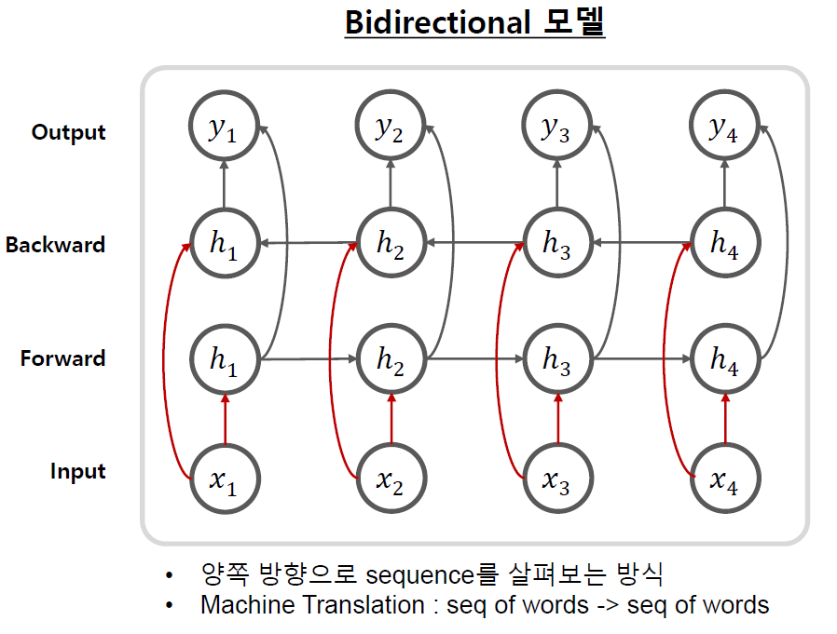
PNP
PASSSION & PIONEER
Recurrent Nerual Network
RNN – Bidrectional
단, 빨리 들어간 데이터는 까먹을 수도 있습니다.

Slide 21
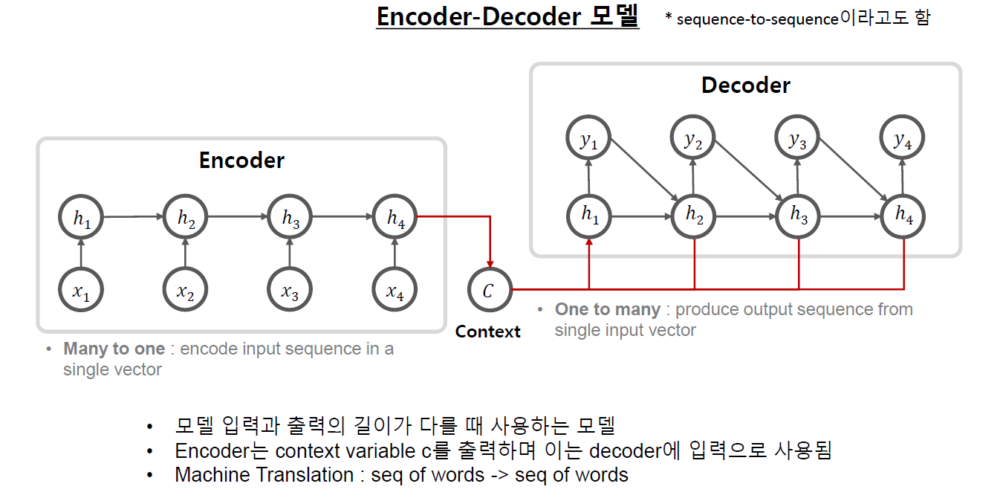
PNP
PASSSION & PIONEER
Recurrent Nerual Network
RNN - Encoder-Decoder (Seq2Seq)

Slide 22
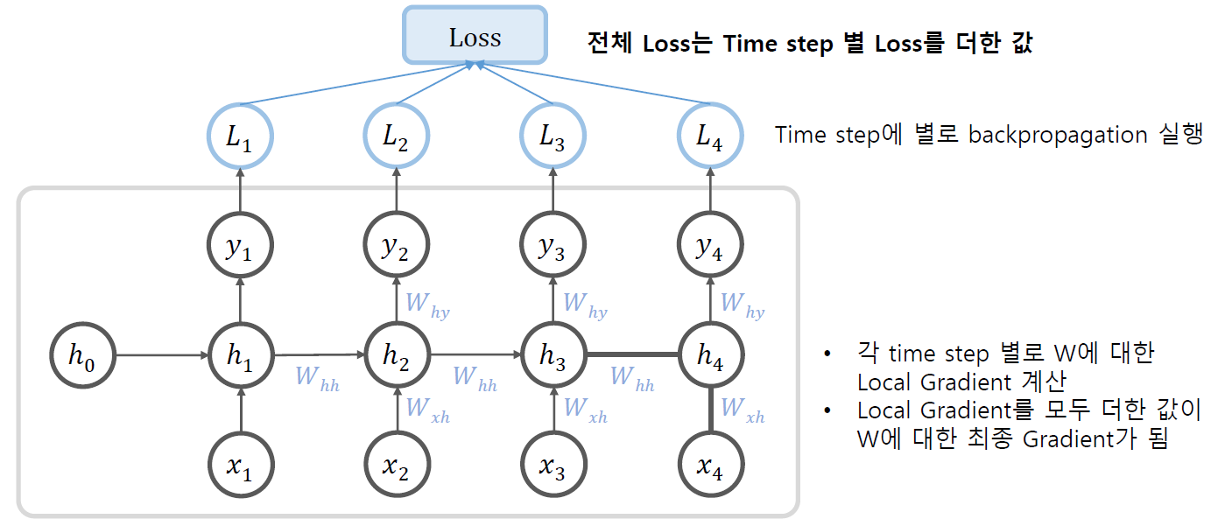
PNP
PASSSION & PIONEER
Recurrent Nerual Network
RNN - Backpropagation

Slide 23
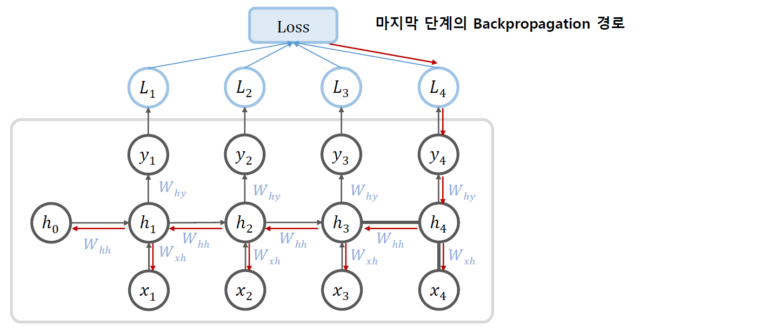
PNP
PASSSION & PIONEER
Recurrent Nerual Network
RNN - Backpropagation

Slide 24
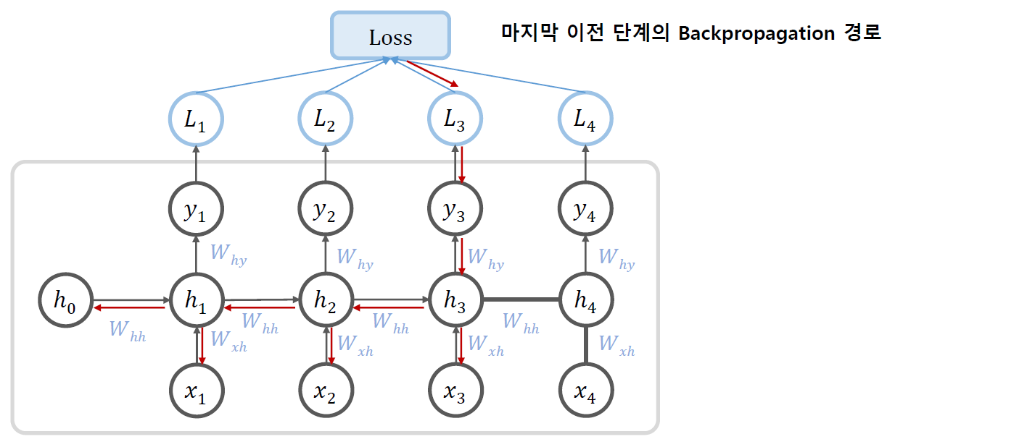
PNP
PASSSION & PIONEER
Recurrent Nerual Network
RNN - Backpropagation

Slide 25
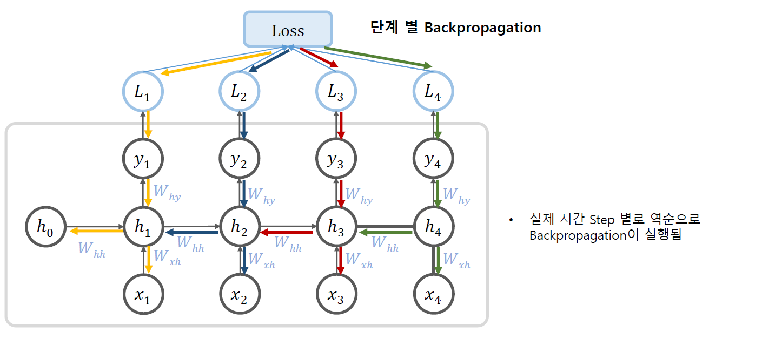
PNP
PASSSION & PIONEER
Recurrent Nerual Network
RNN - Backpropagation

Slide 26
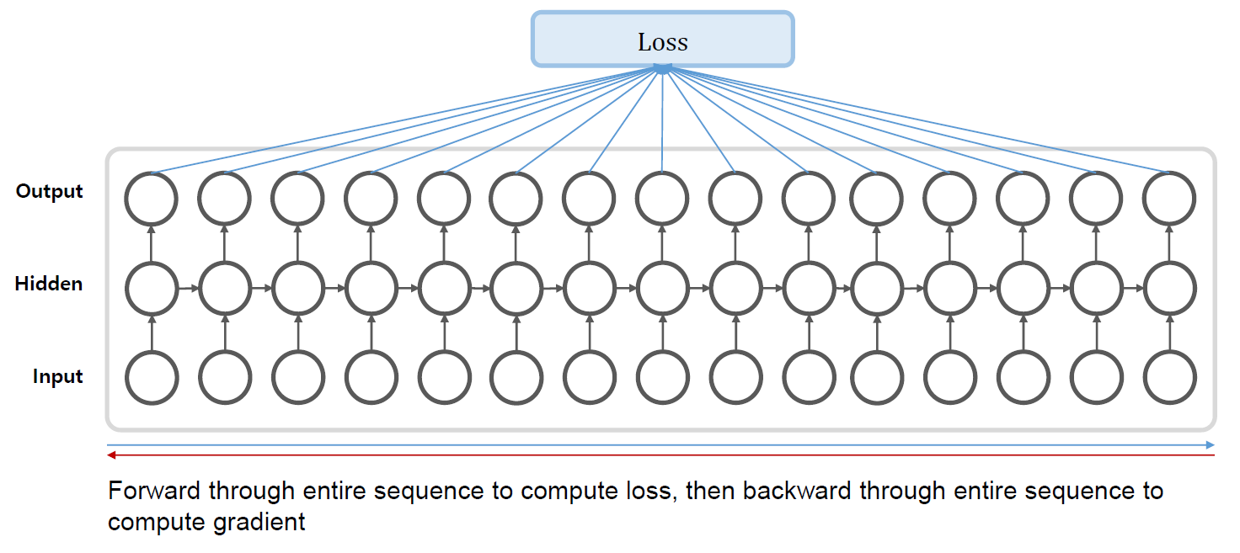
PNP
PASSSION & PIONEER
Recurrent Nerual Network
RNN - Backpropagation Through Time
전체 시퀀스를 통해 전달하여 손실을 계산한 다음 전체 시퀀스를 통해 역방향으로 전달하여 기울기를 계산합니다

Slide 27
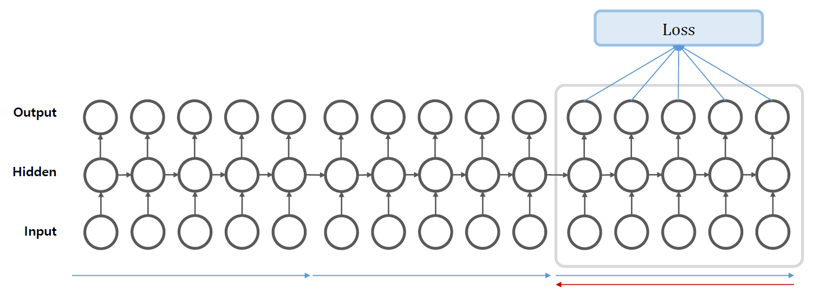
PNP
PASSSION & PIONEER
Recurrent Nerual Network
Truncated BPTT
Sequence가 긴 경우 중간을 마다 학습을 진행
(역전파만 끊어서 진행)

Slide 28
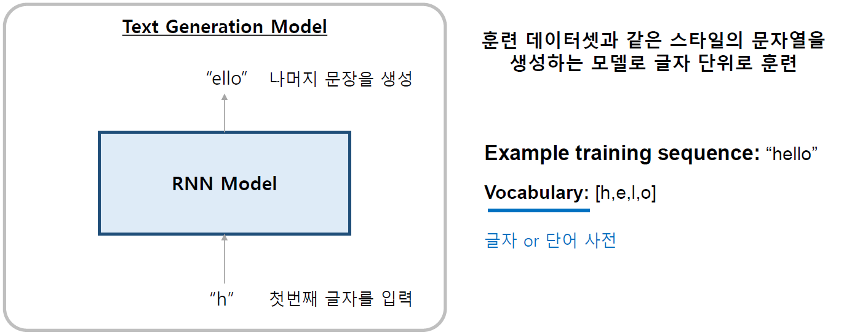
PNP
PASSSION & PIONEER
Recurrent Nerual Network
RNN example

Slide 29
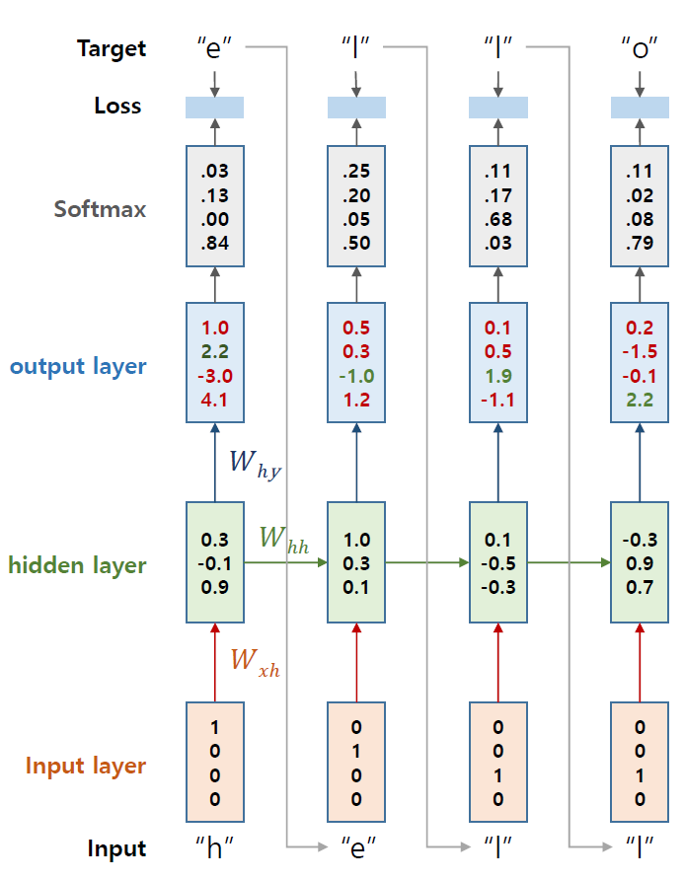
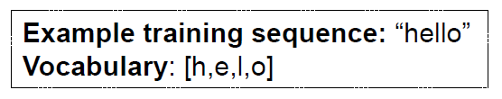
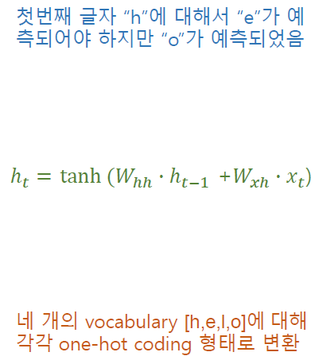
PNP
PASSSION & PIONEER
Recurrent Nerual Network
RNN Train

Slide 30
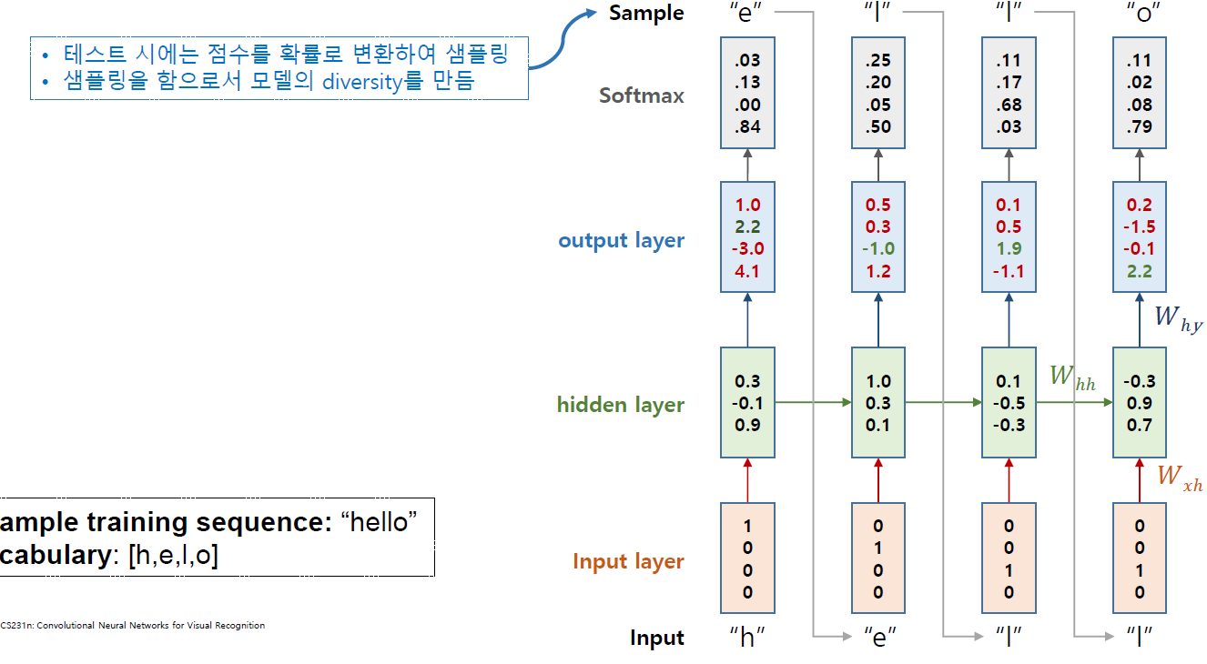
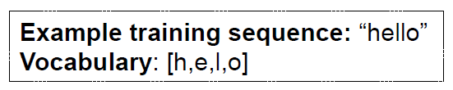
PNP
PASSSION & PIONEER
Recurrent Nerual Network
RNN Test
이번 Sequence의 예측 값을 다시 다음 Sequence의 input으로 사용

Slide 31
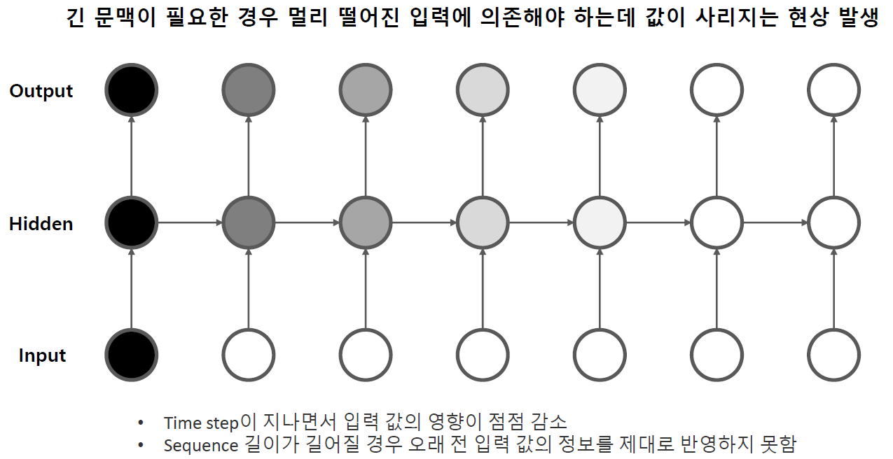
PNP
PASSSION & PIONEER
Recurrent Nerual Network
Long-Term Dependency

Slide 32
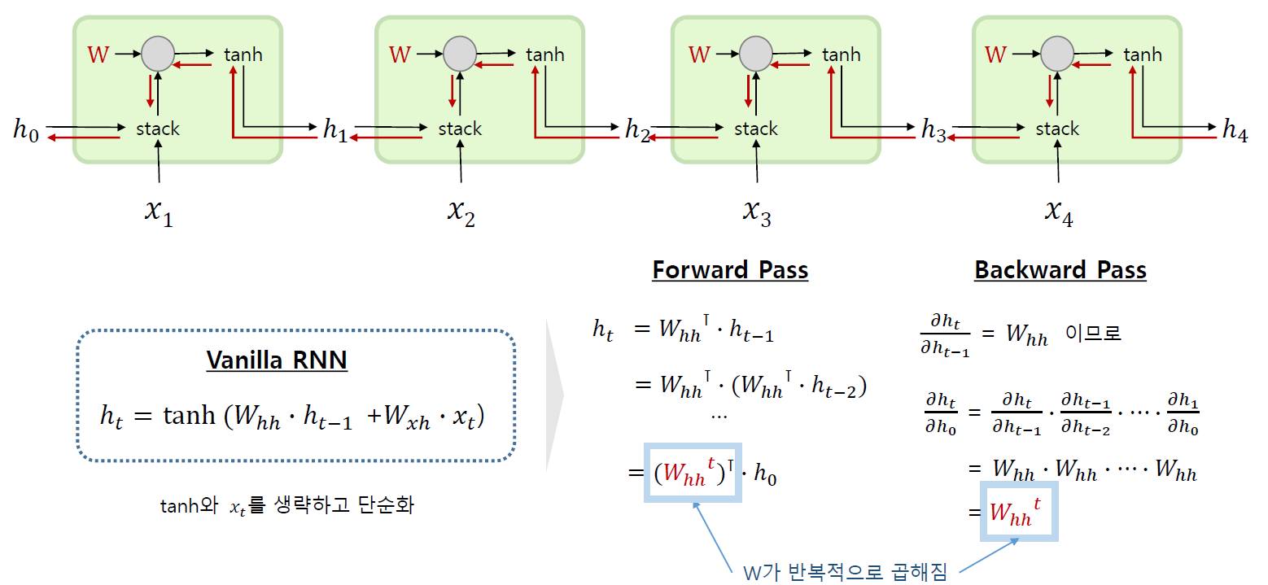
PNP
PASSSION & PIONEER
Recurrent Nerual Network
RNN Gradient Vanishing / Exploding

Slide 33
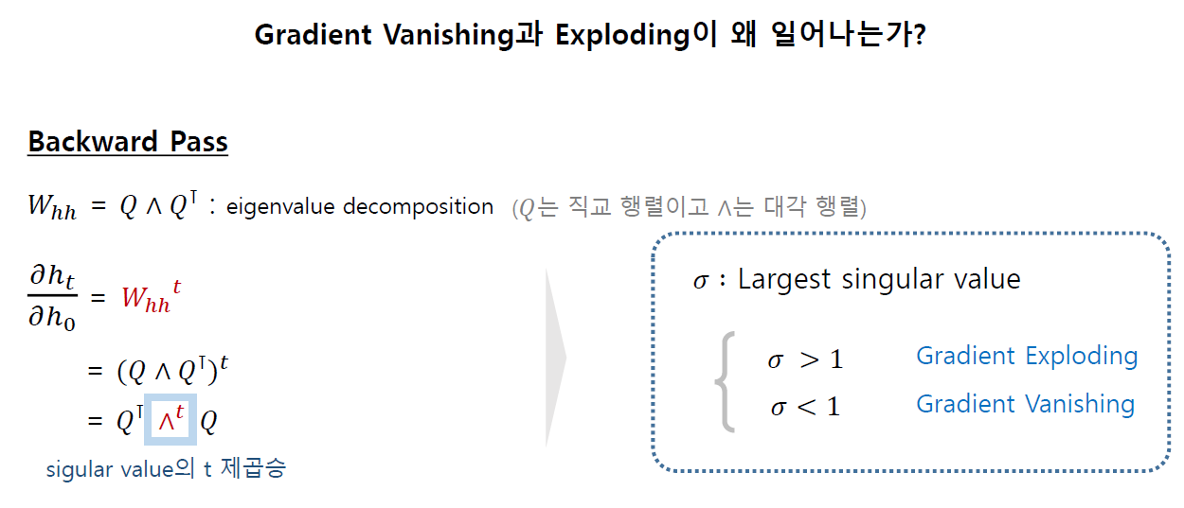
PNP
PASSSION & PIONEER
Recurrent Nerual Network
RNN Gradient Vanishing / Exploding

Slide 34
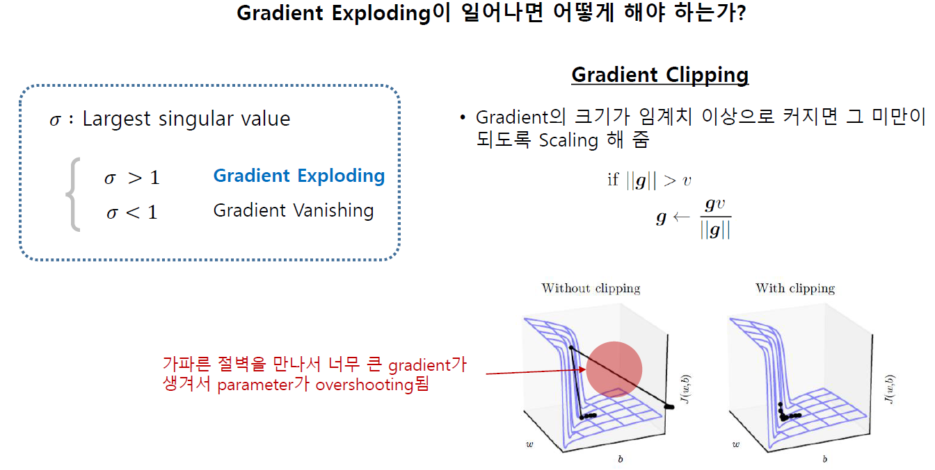
PNP
PASSSION & PIONEER
Recurrent Nerual Network
RNN Gradient Exploding
Weight(가중치)자체가 커져버리면 줄이면 됩니다.
그러나 그러면 Gradient Vanishing (기울기 손실)문제가 있습니다.

Slide 35
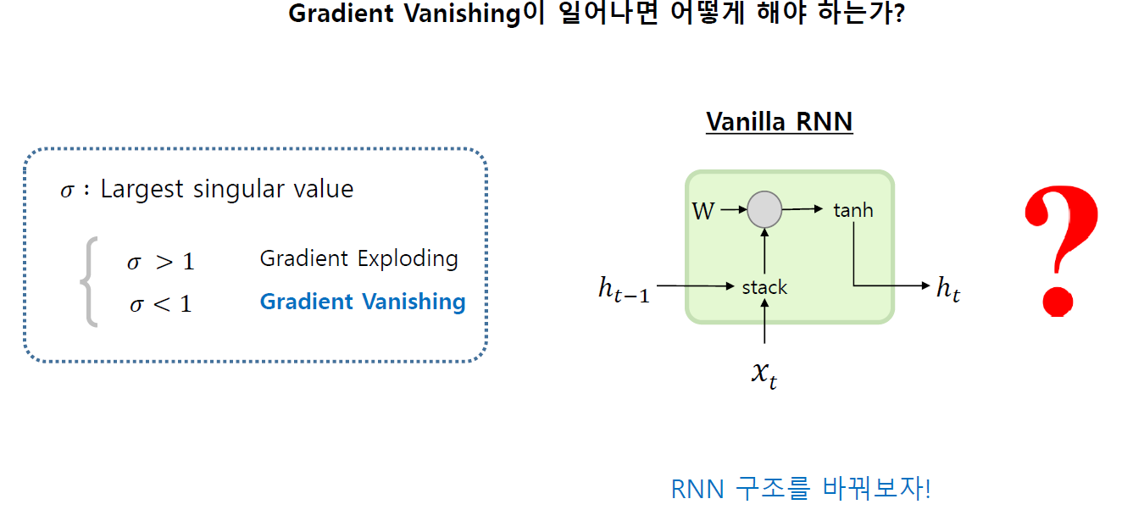
PNP
PASSSION & PIONEER
Recurrent Nerual Network
RNN Gradient Exploding

Slide 36
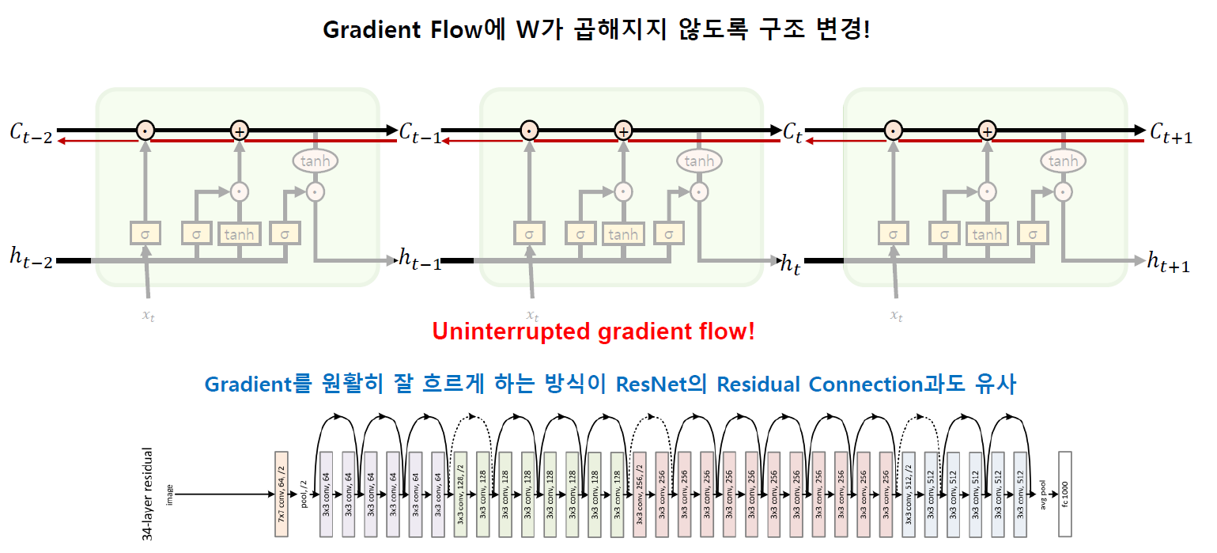
PNP
PASSSION & PIONEER
Recurrent Nerual Network
Long Short Term Memory - LSTM
기억 파트: Sigmoid = 1
잊어버리는 파트: Sigmoid = 2

Slide 37
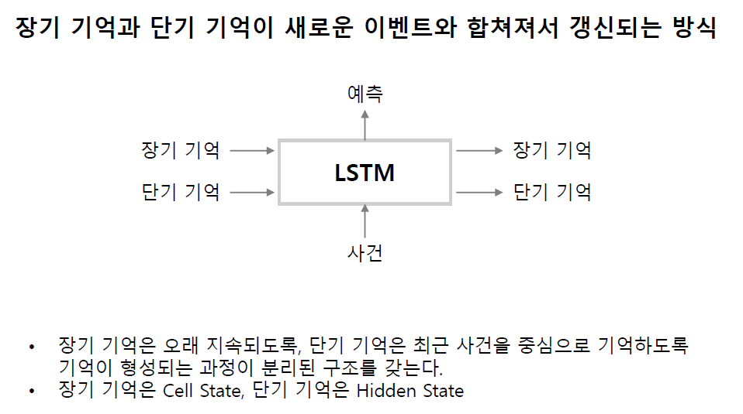
PNP
PASSSION & PIONEER
Recurrent Nerual Network
Long Short Term Memory - LSTM

Slide 38
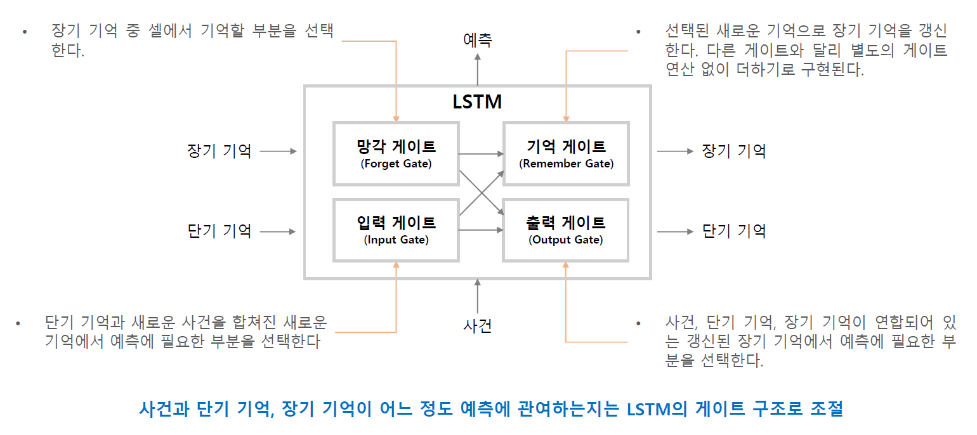
PNP
PASSSION & PIONEER
Recurrent Nerual Network
Long Short Term Memory - LSTM
LSTM 모델의 활성화 함수: Sigmoid
Gate: Dense(0, Sigmoid)

Slide 39
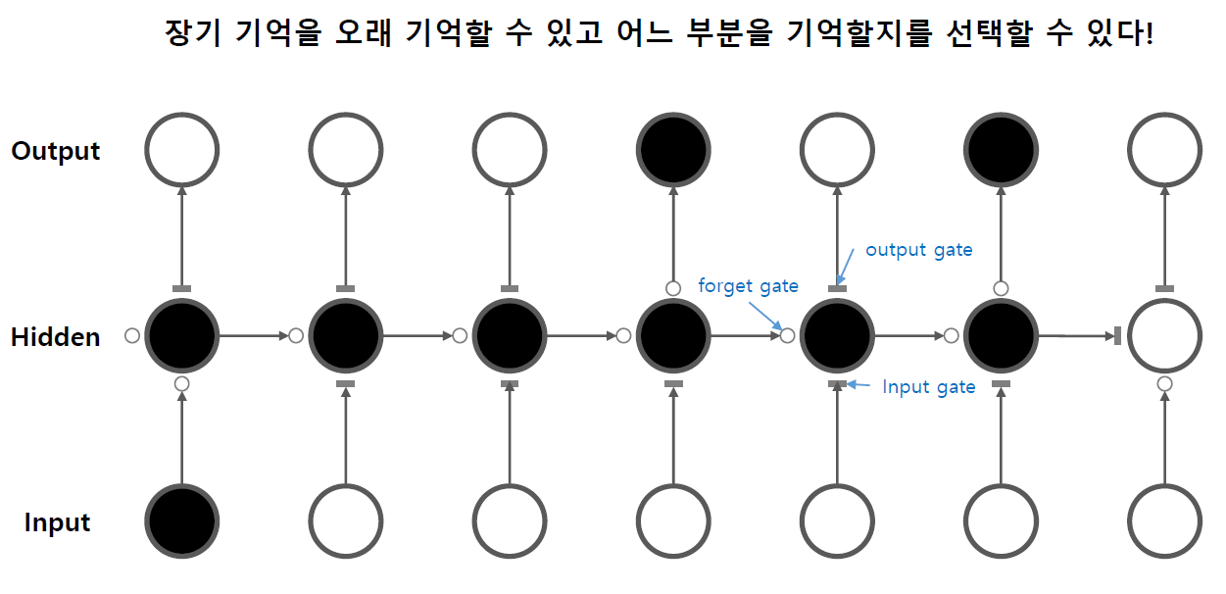
PNP
PASSSION & PIONEER
Recurrent Nerual Network
Long Short Term Memory - LSTM

Slide 40
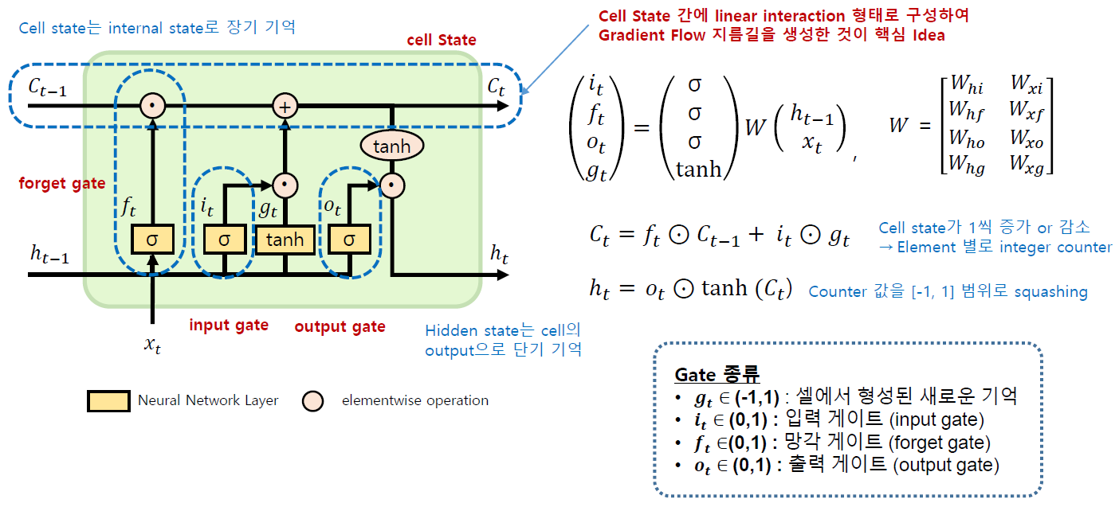
PNP
PASSSION & PIONEER
Recurrent Nerual Network
Long Short Term Memory - LSTM

Slide 41
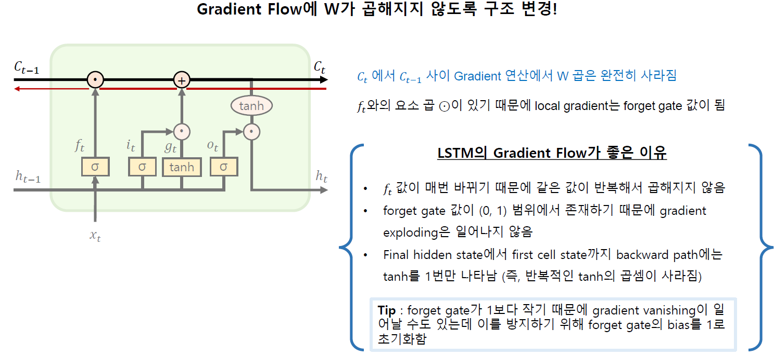
PNP
PASSSION & PIONEER
Recurrent Nerual Network
Long Short Term Memory - LSTM

Slide 42
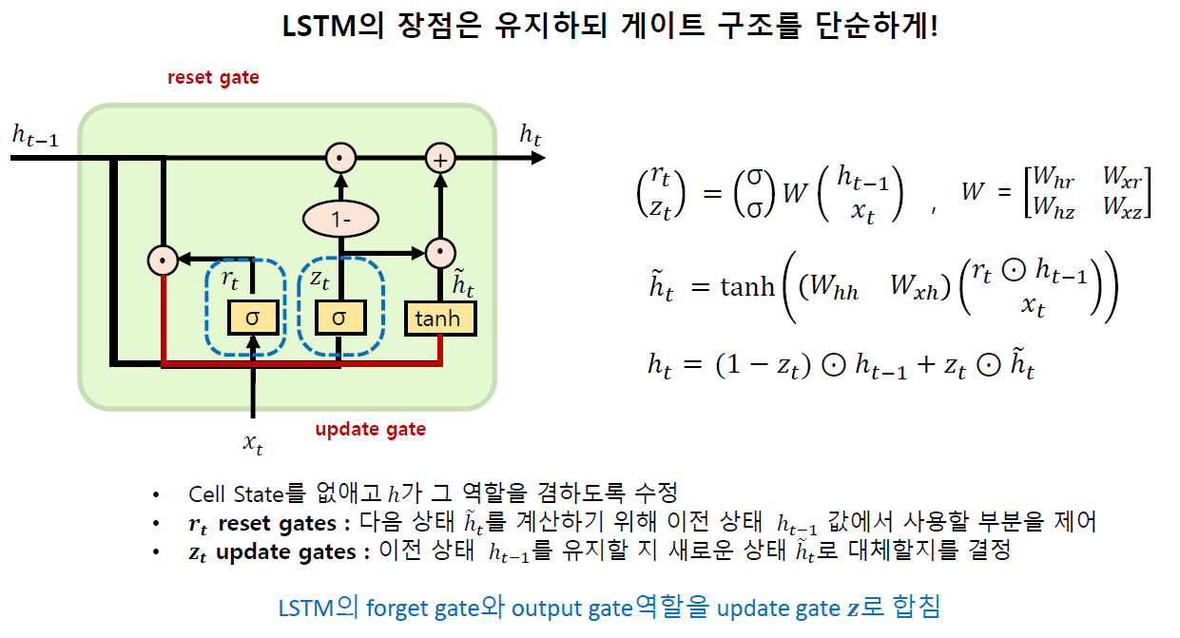
PNP
PASSSION & PIONEER
Recurrent Nerual Network
Long Short Term Memory - GRU
LSTM 모델을 가볍게

Slide 43
PNP
Q & A ?
밑바닥부터 시작하는 딥러닝 1, 2 http://www.yes24.com/Product/Goods/34970929?Acode=101 http://www.yes24.com/Product/Goods/72173703
모두를 위한 딥러닝 시즌2 https://www.edwith.org/boostcourse-dl-tensorflow/joinLectures/22150

